Slide 1
SIT313 - Developing Client Server Web Application
Developing Client-Server Web Applications
Name: Sameera Dinusha Priyananda
SID:2151 215158268
Project 01

Slide 2
Fruits and Vegetables identification game App
Game App Name: Kids preschool game
App target audience: Under 8 children
App platform: Xamarin with Android
App description: This app will helps to learn fruits and vegetable names for small children.
Multiscreen app: (3 screens)

Slide 3
Features of the Game App
Pop-up an alert when the answer is correct or incorrect
Play a music while user playing the game
User can mute the music anytime
Screen Rotation

Slide 4
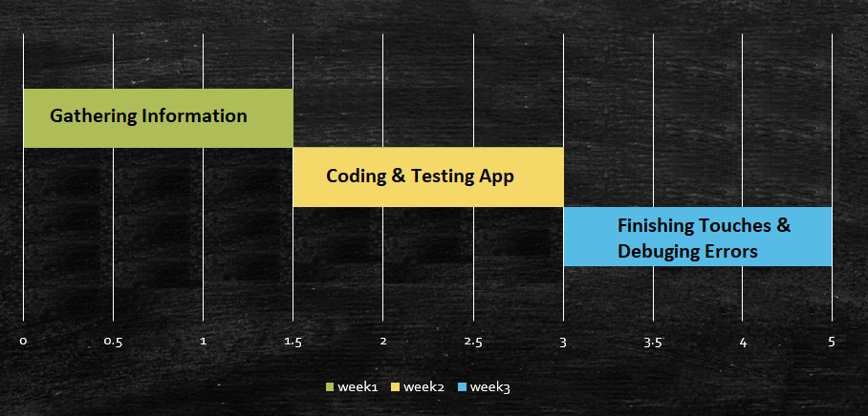
Project timeline

Slide 5
GitHub Link
https://github.com/samara92/SIT313_Project1
Project Proposal Video Link: https://github.com/samara92/SIT313_Project1/blob/master/Project%20proposal%20video.mp4

Slide 6
Thank You

